Slide 1

E – Commerce Sales Analysis Full Project
An effective E-Commerce Sales Analysis breaks down raw transactional data into actionable insights about revenue generation, product velocity, and seasonal trends.

Slide 2
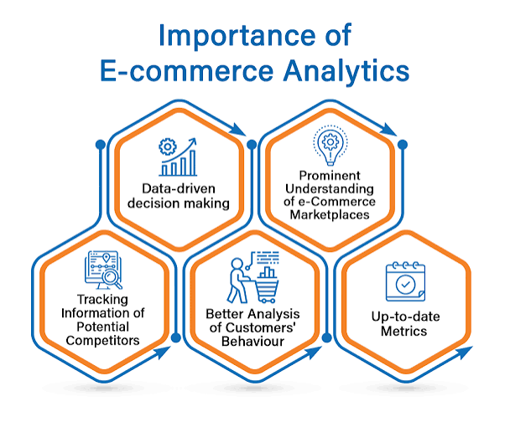
E – Commerce Sales Database Analytics
To analyze and track e-commerce database metrics effectively, you need to monitor metrics across three core pillars: financial performance, customer behavior, and inventory health.

Slide 3


Slide 4
Questions
1. You need to calculate the monthly sales of the store and identify which month had the highest sales and which month had the lowest sales.
2. You need to analyze sales based on product categories and determine which category has the lowest sales and which category has the highest sales. 3. The sales analysis needs to be done based on sub-categories.
4. You need to analyze the monthly profit from sales and determine which month had the highest profit.
5. Analyze the profit by category and sub-category.
6. Analyze the sales and profit by customer segment.
7. Analyze the sales to profit ratio.

